Slide 1
Greater Research Impact
Kudos
David Sommer
Director and Co-Founder
1:AM London 2014

Slide 2
1:AM
1996
2006

Slide 3
the idea
1996
2006

Slide 4

Discoverability is
the new challenge
Notes:
[MOVE QUICKLY THROUGH ALL OF THIS]

Slide 5

Impact matters
Measurement is more complex
Notes:
[MOVE QUICKLY THROUGH ALL OF THIS]

Slide 6

Communication capabilities are accelerating
Notes:
[MOVE QUICKLY THROUGH ALL OF THIS]

Slide 7

The gap
Authors are the missing link in increasing the impact of their publications

Slide 8

Kudos fills that gap
Helping maximize the impact of published research by:
Empowering authors to explain, enrich and share their work
Using article-level metrics to motivate and reward them
Making research more accessible to a broader audience
Linking up research assets to create research stories

Slide 9
Author attitudes

Slide 10
Author attitudes

Slide 11
the service
1996
2006

Slide 12
14 Week Pilot in 2013
19% higher
article usage per day
for articles shared using the Kudos tools compared to the control group

Slide 13



















Our partners for 2014
13

Slide 14
Launched May 2014
19,000+ registrations
1,000+ new registrations weekly
218,000 publications claimed
Free for authors to use
Currently funded by publishers

Slide 15
how it works
1996
2006

Slide 16
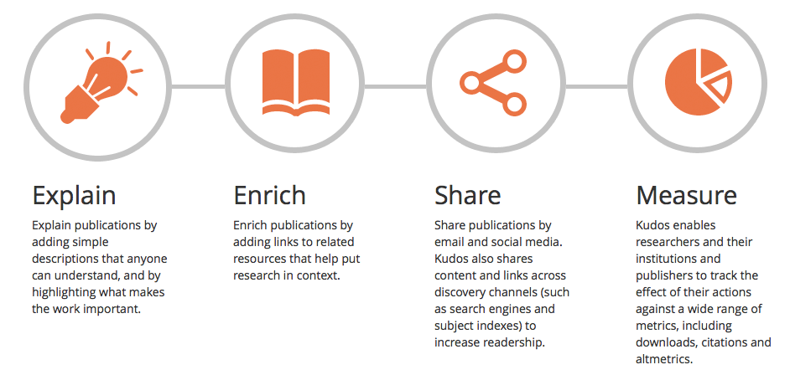
4 key concepts

Slide 21
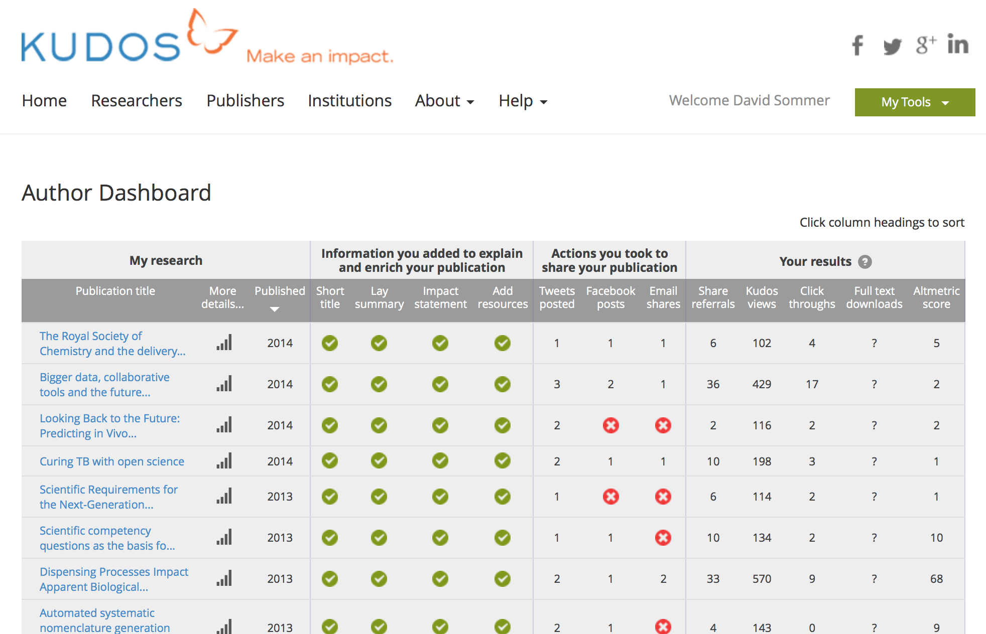
Notes:
The author’s profile

Slide 22
Notes:
The author’s profile

Slide 23
A typical example

Slide 24
In the hands of a super user
http://www.chemconnector.com/2014/06/20/give-me-kudos-for-my-articles/
Notes:
Tony Williams has really embraced Kudos and has agreed to join our User Advisory Board with other authors to help steer Kudos. He really sees Kudos becoming something very special – a place for all your publications and resources.

Slide 25
In the hands of a super user
Within two weeks of registration ….
138 claims
12 shares
45 share
referrals
1240 Kudos views
431 downloads
http://www.chemconnector.com/2014/06/20/give-me-kudos-for-my-articles/

Slide 26
In the hands of a super user
Notes:
What’s he trialling? Bringing awareness to older but still very relevant publications.

Slide 27
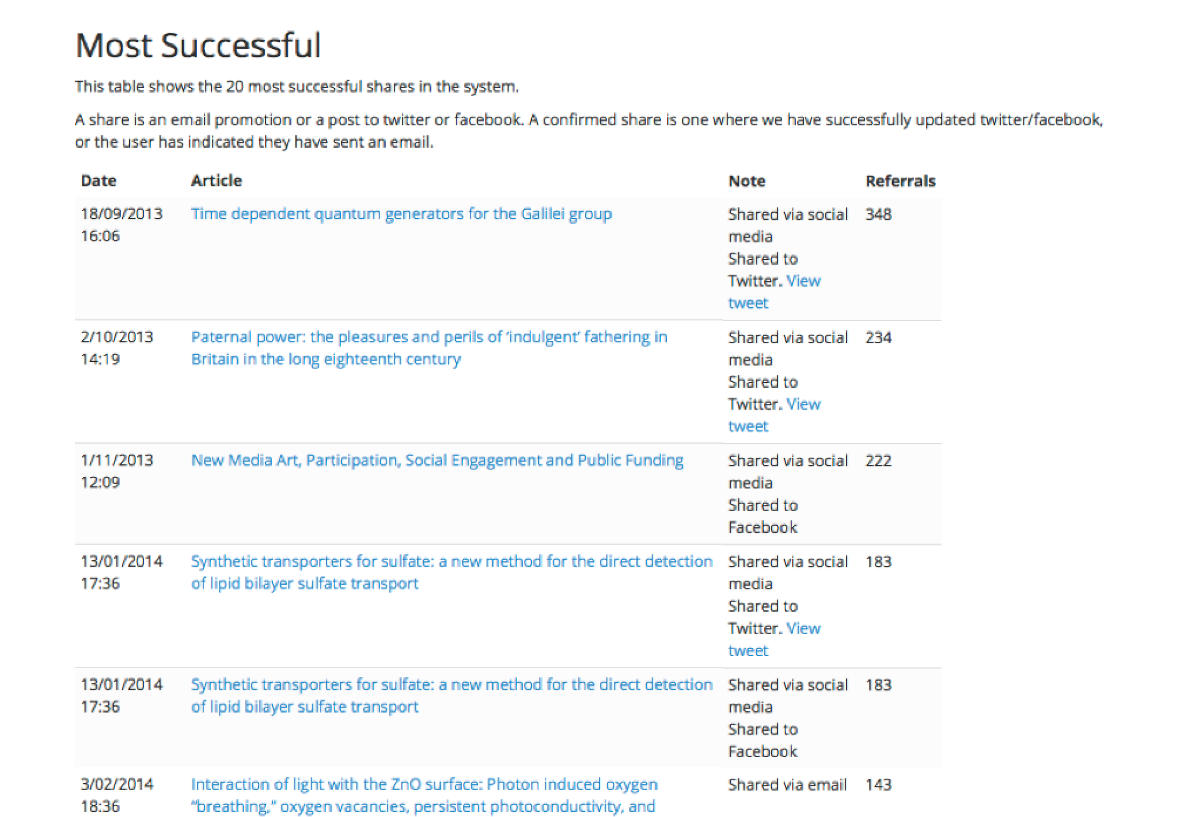

Slide 28
What is next?
1996
2006

Slide 29

ORCID Integration
Notes:
What’s he trialling? Bringing awareness to older but still very relevant publications.

Slide 30
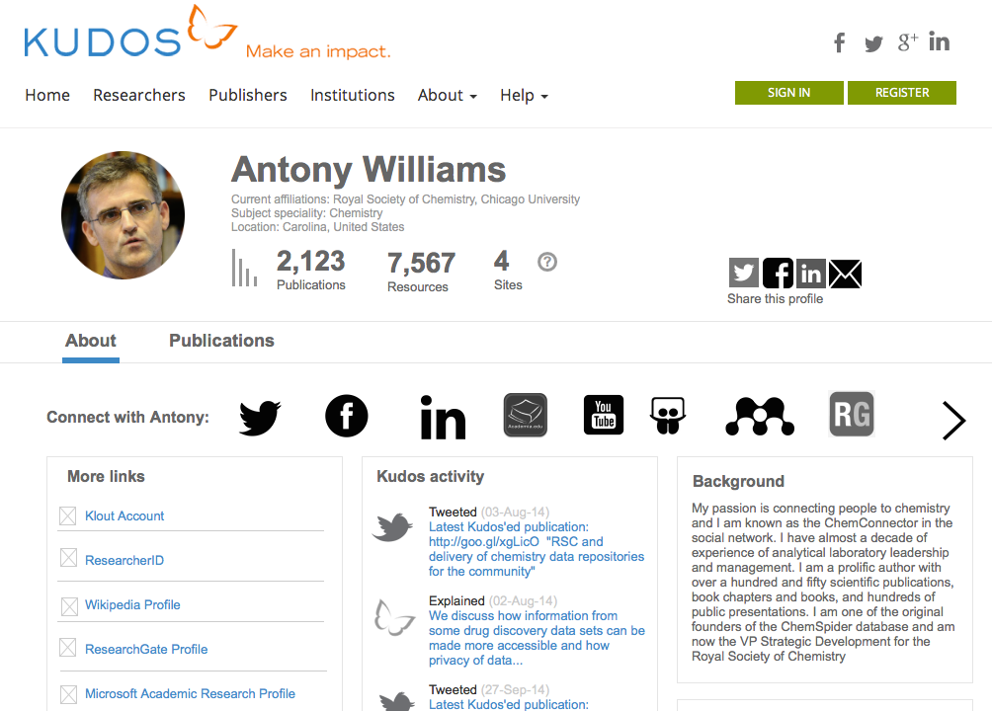
New UI
Notes:
What’s he trialling? Bringing awareness to older but still very relevant publications.

Slide 31
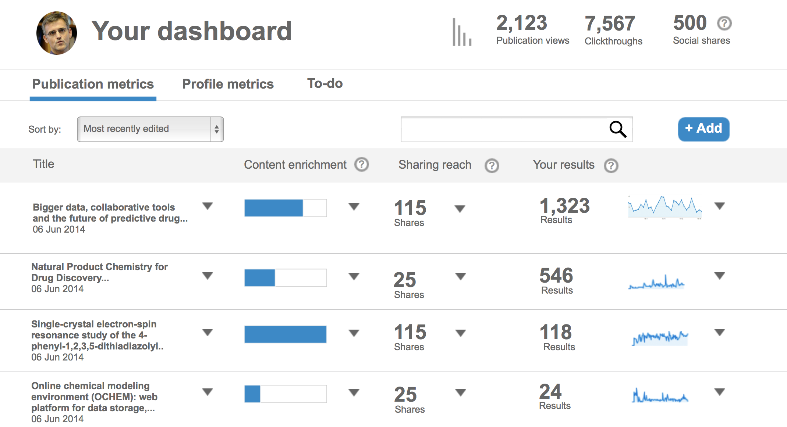
New UI
Notes:
What’s he trialling? Bringing awareness to older but still very relevant publications.

Slide 32
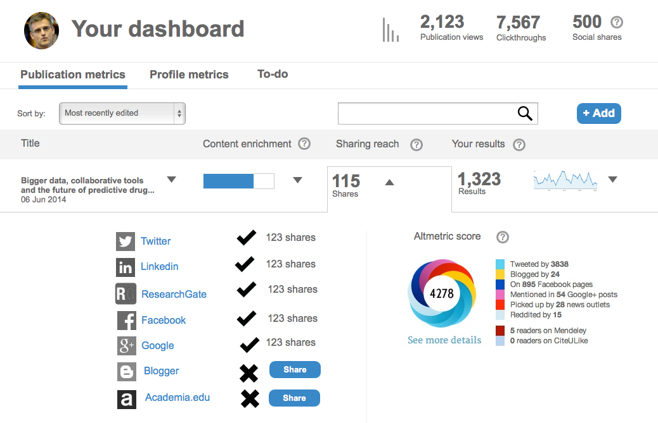
New UI
Notes:
What’s he trialling? Bringing awareness to older but still very relevant publications.

Slide 33
Kudos for Institutions
For Institutions
Notes:
What’s he trialling? Bringing awareness to older but still very relevant publications.

Slide 34

Repositories and A&Is
Notes:
What’s he trialling? Bringing awareness to older but still very relevant publications.

Slide 35
Find out more: www.growkudos.com David@growkudos.com @growkudos
1996
2006

